Slide 1


Slide 2
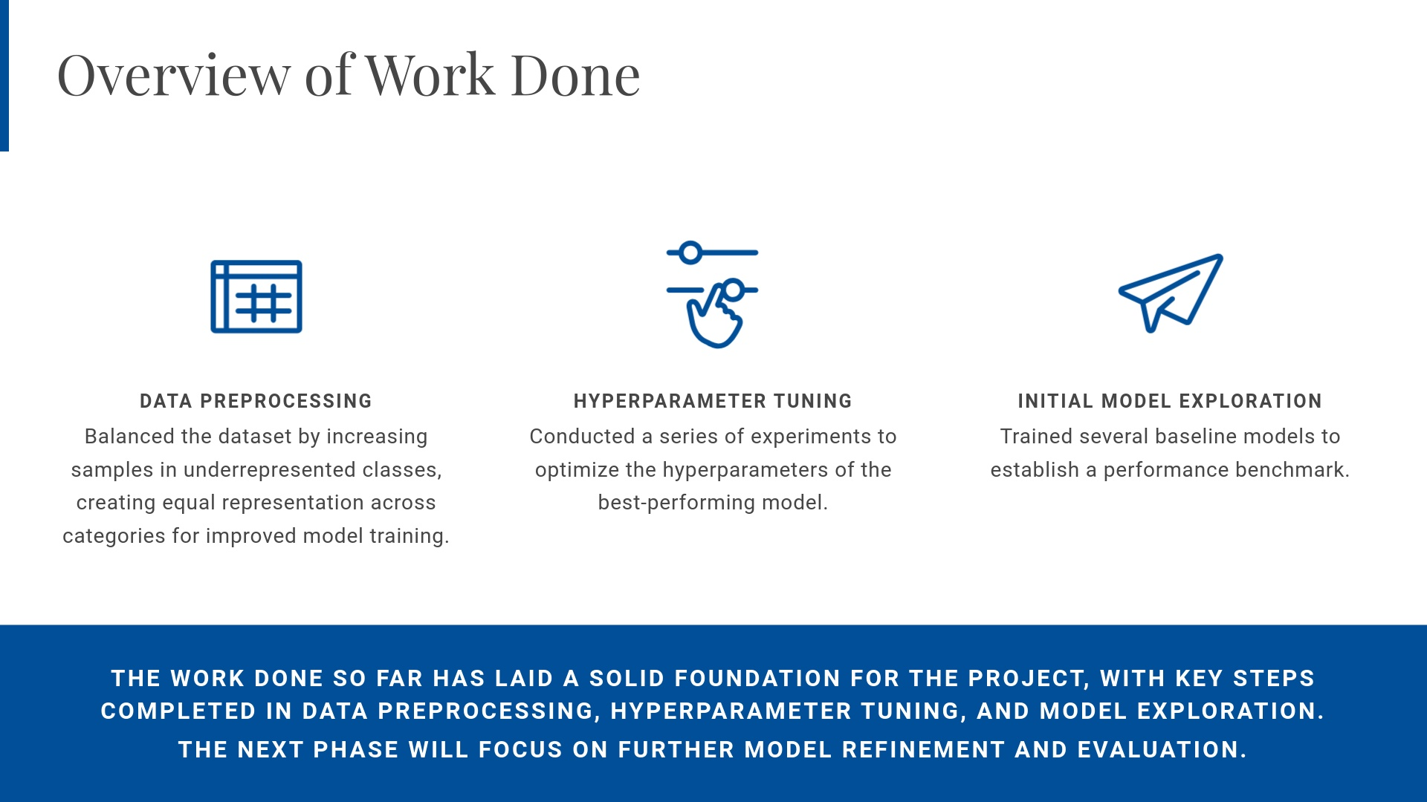

Slide 3
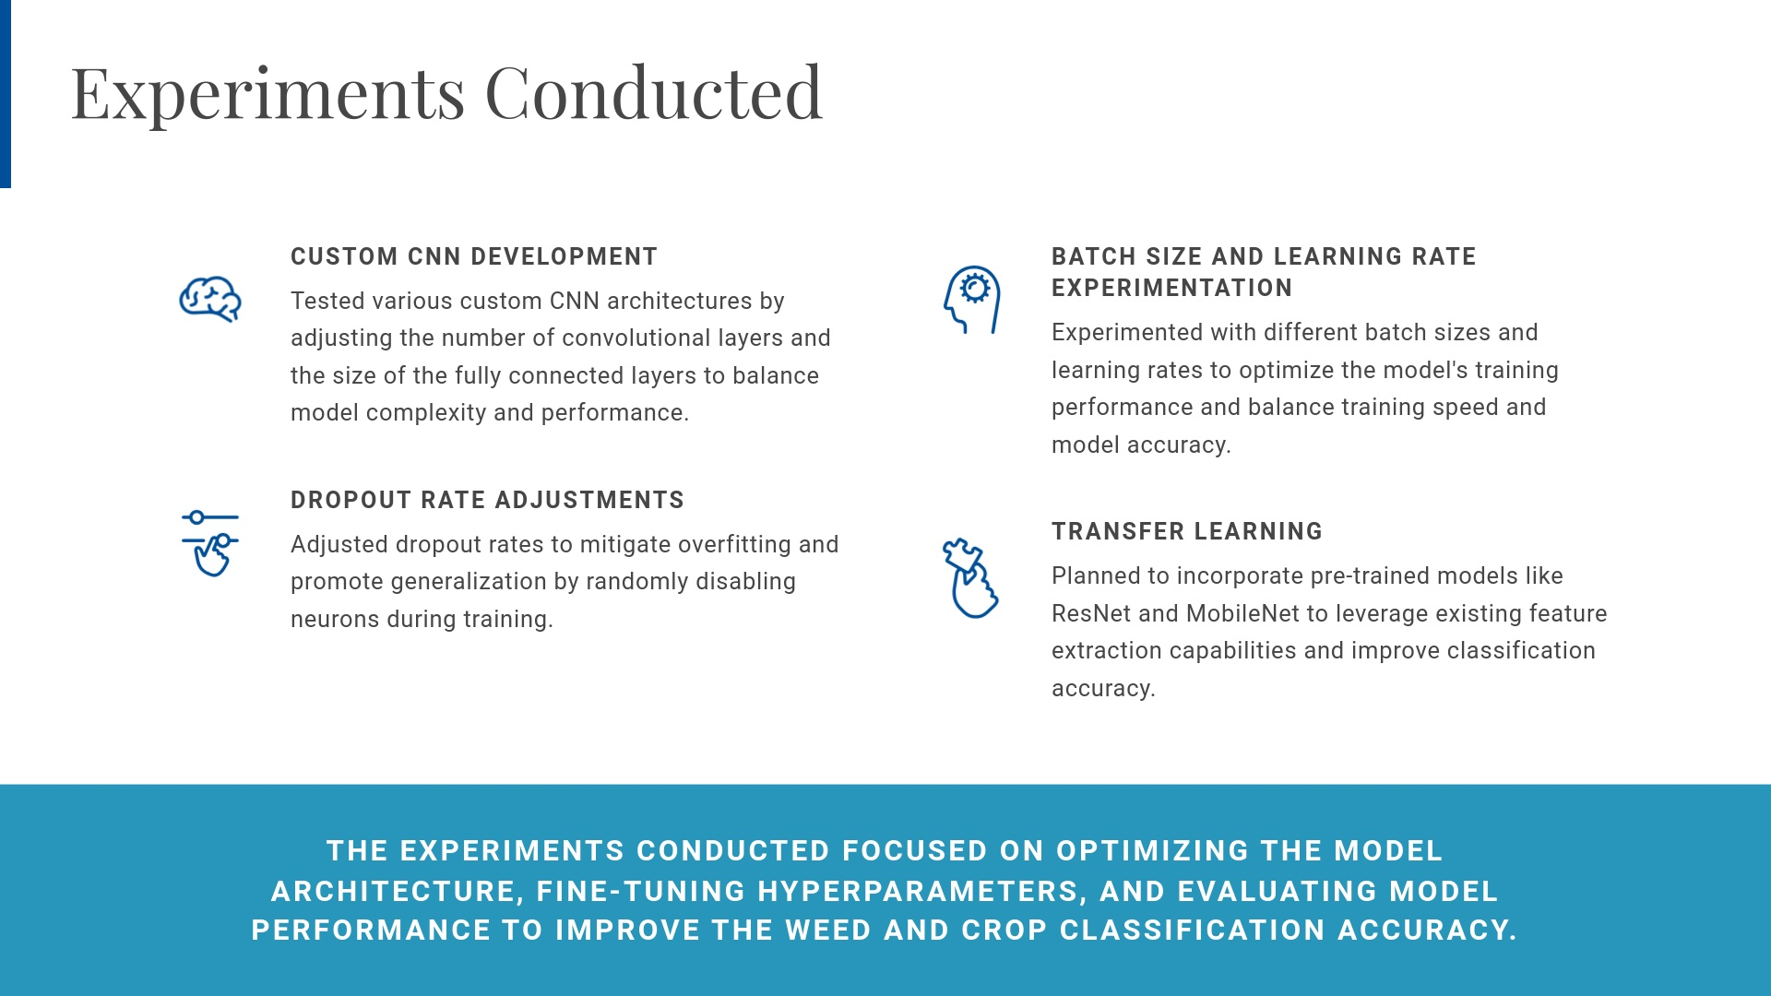

Slide 4
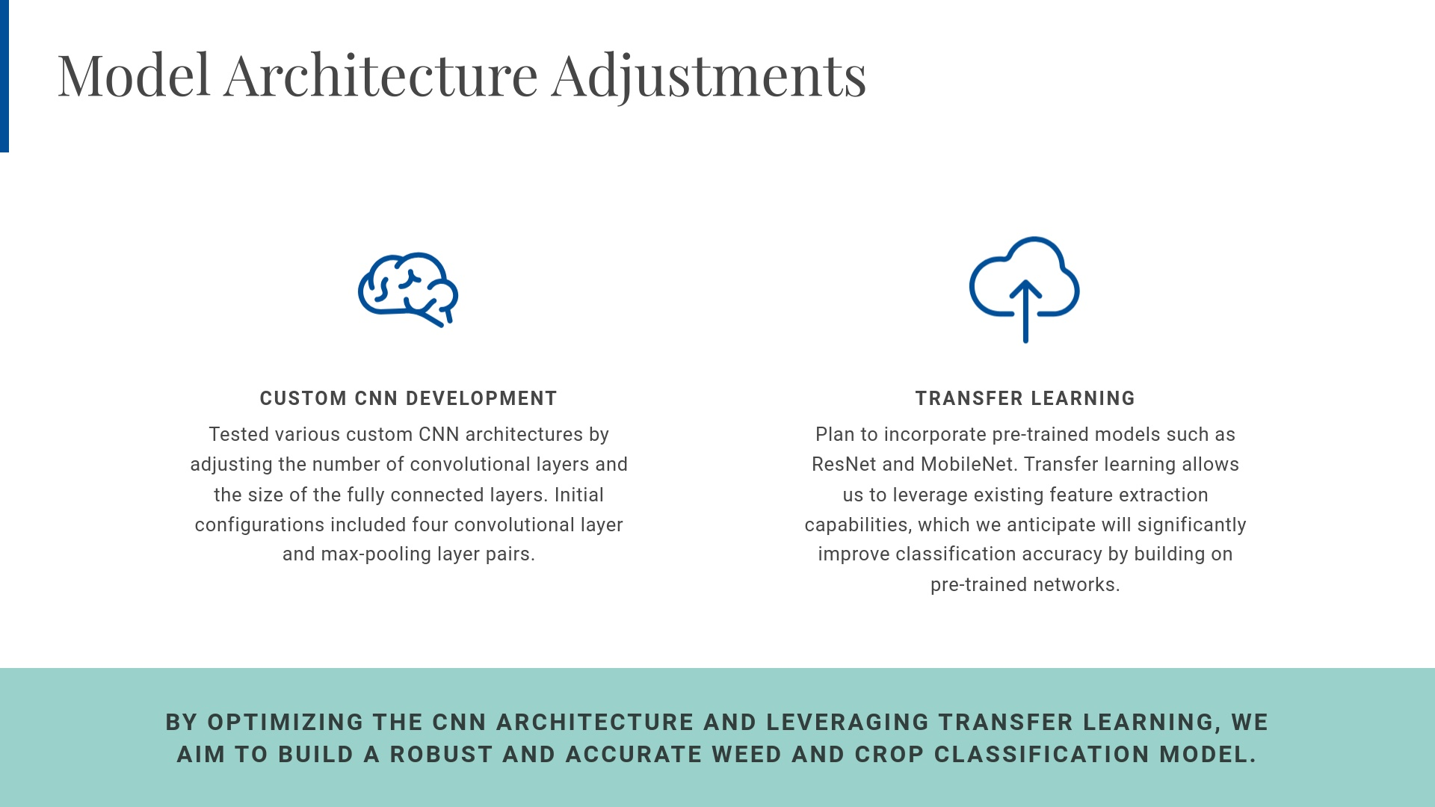

Slide 5
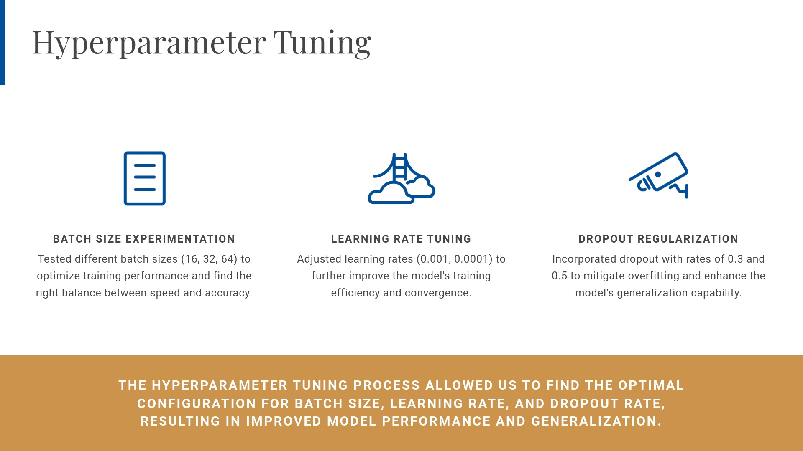

Slide 6
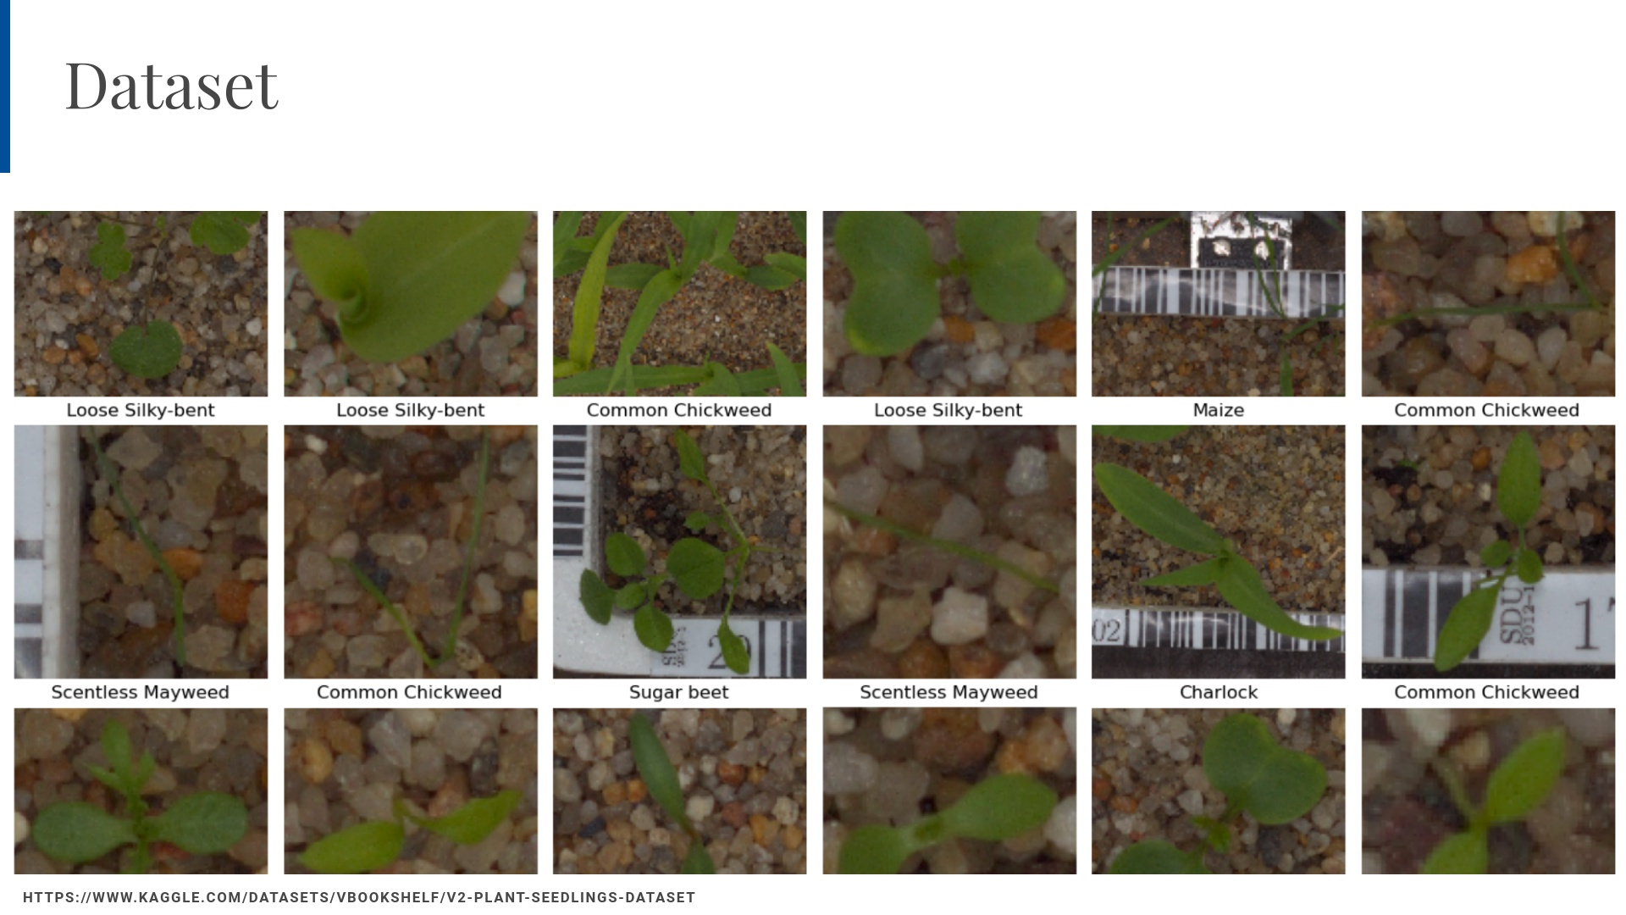

Slide 7
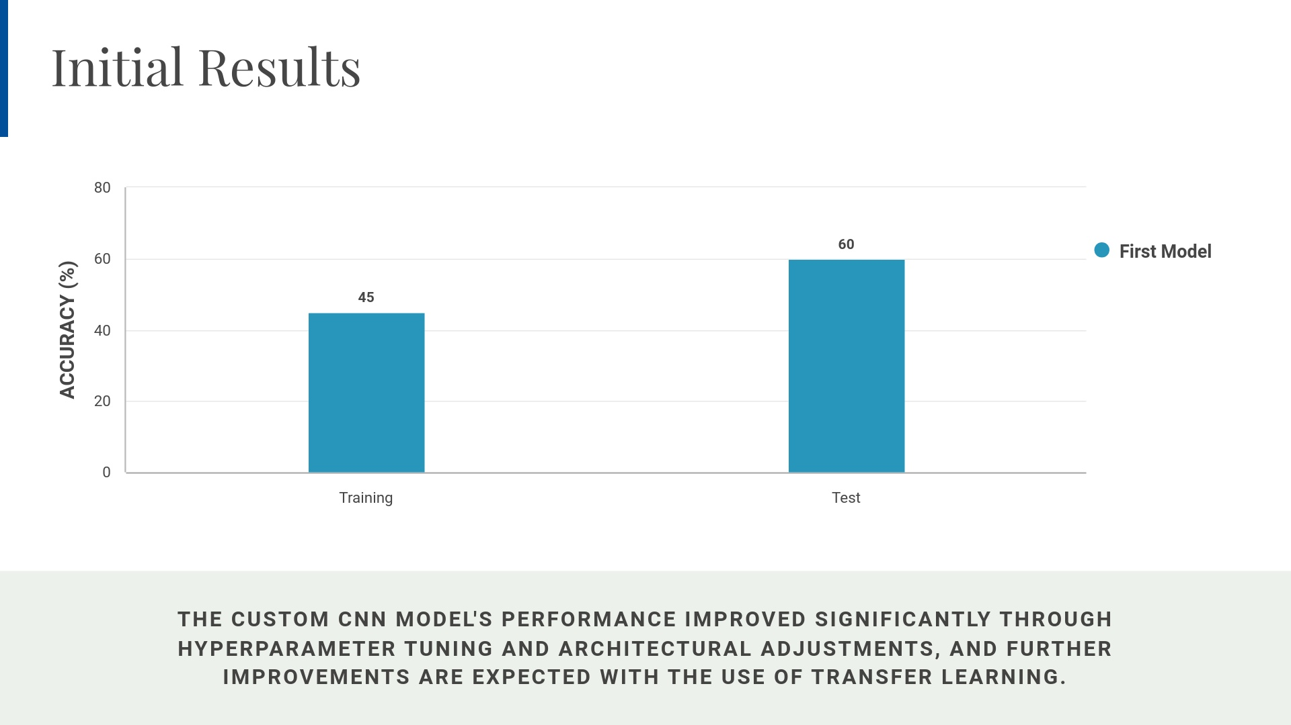

Slide 8
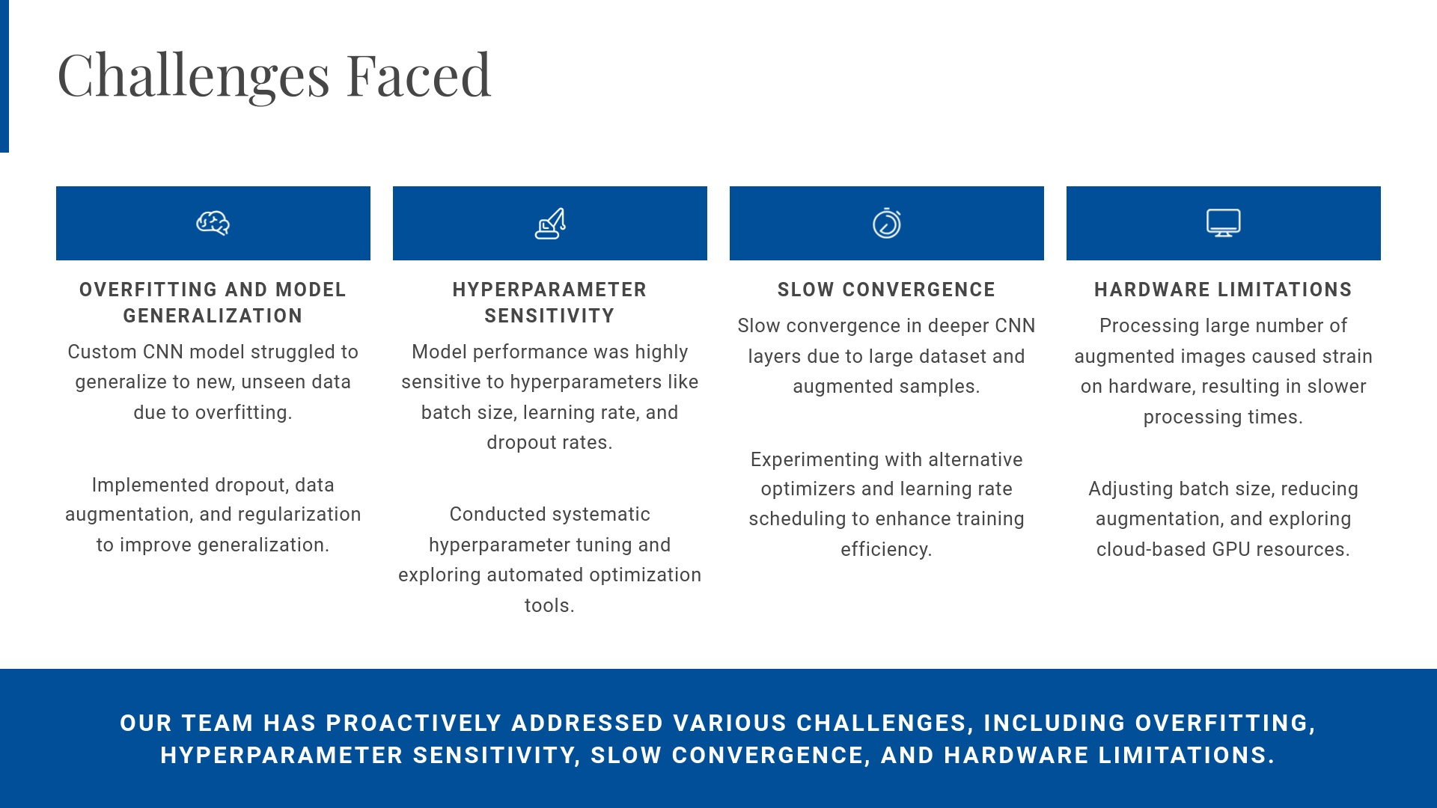

Slide 9
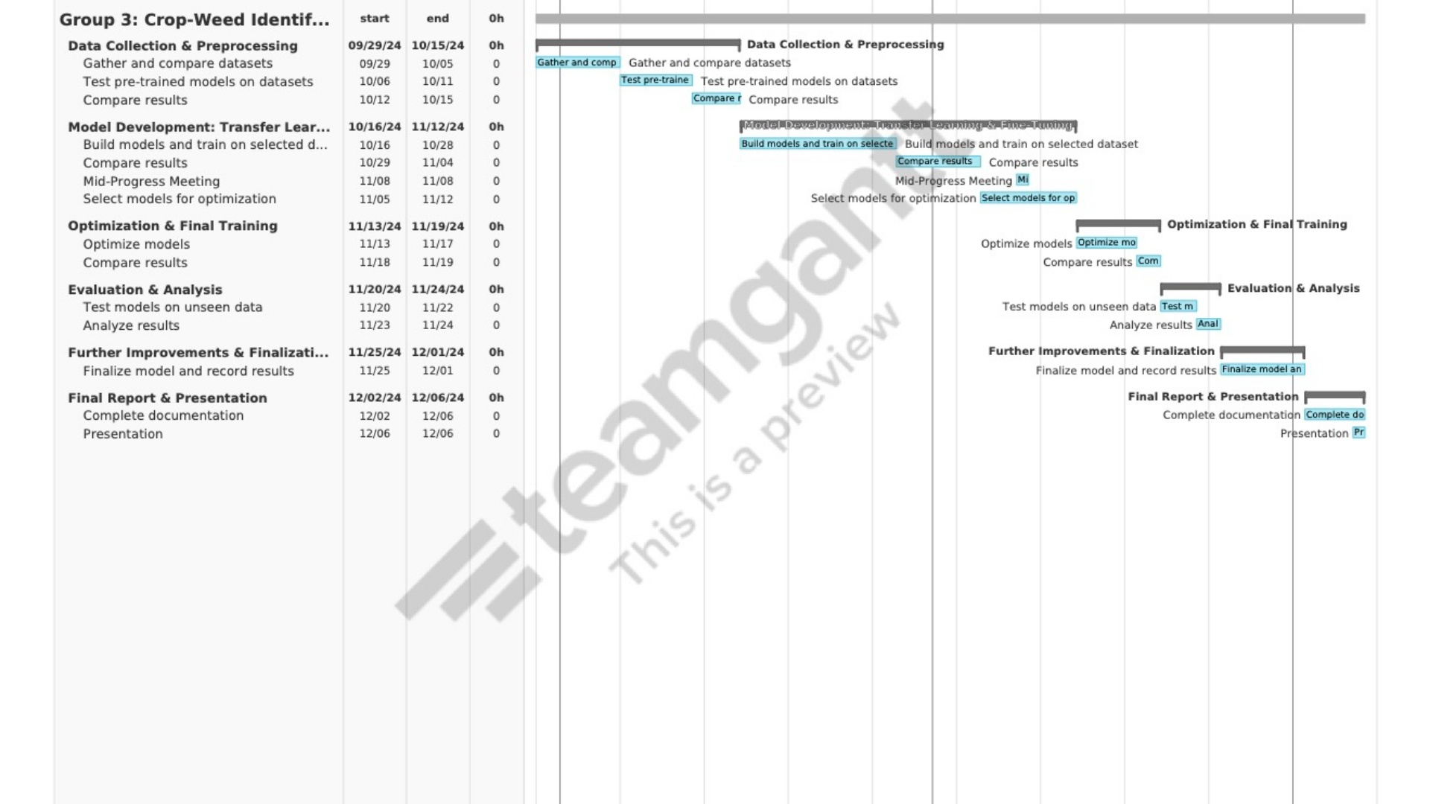

Slide 10
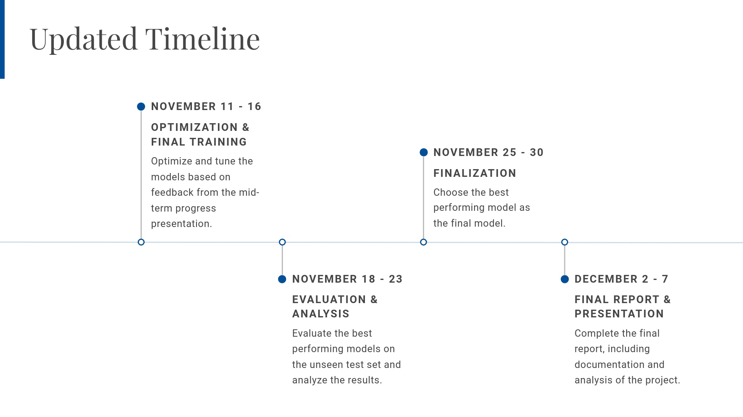

Slide 11
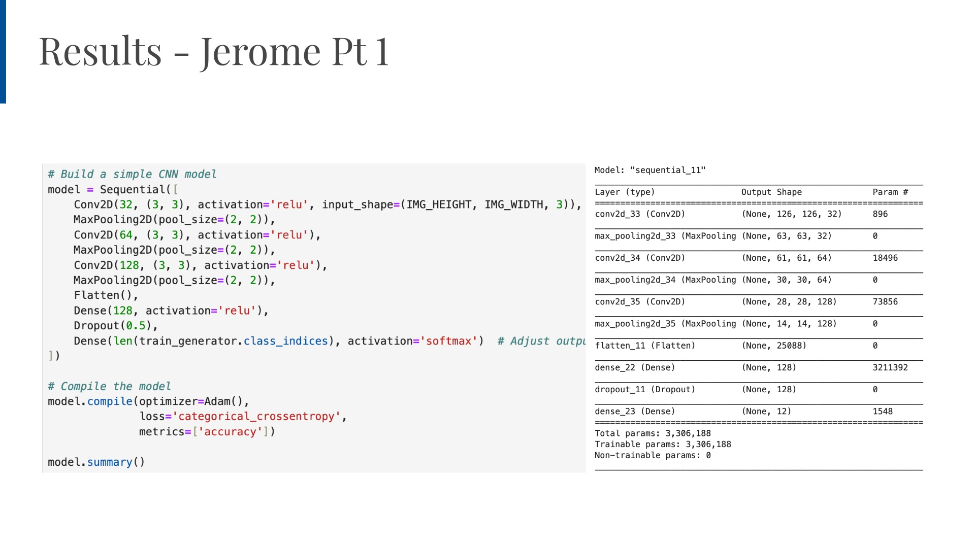
Notes:
Jerome

Slide 12
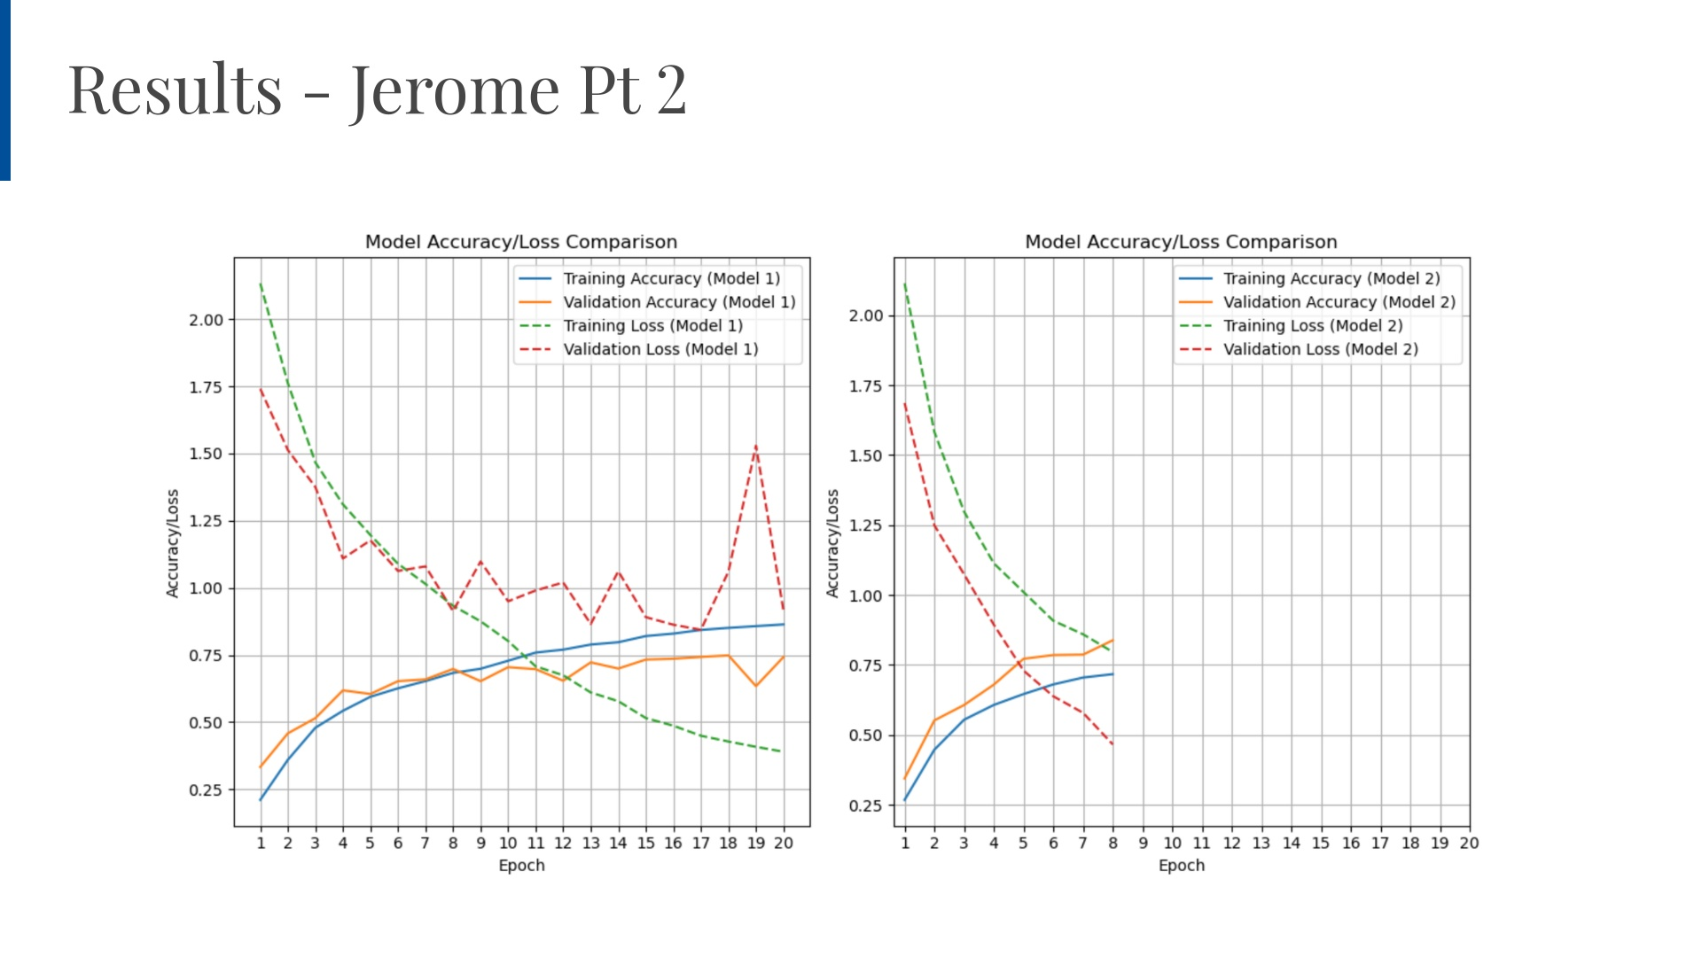
Notes:
AJ

Slide 13
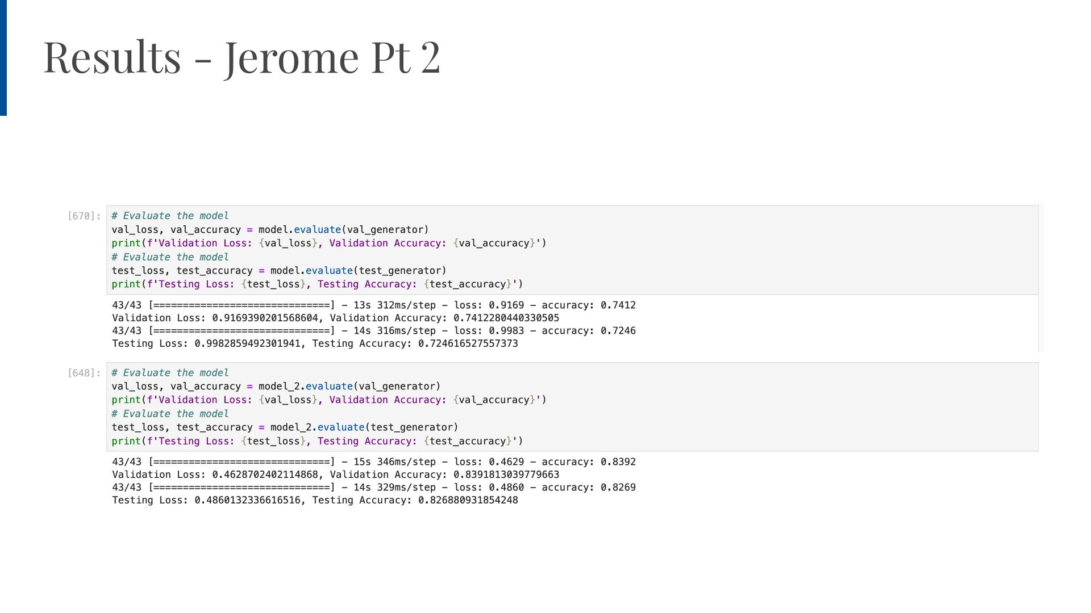
Notes:
AJ

Slide 14
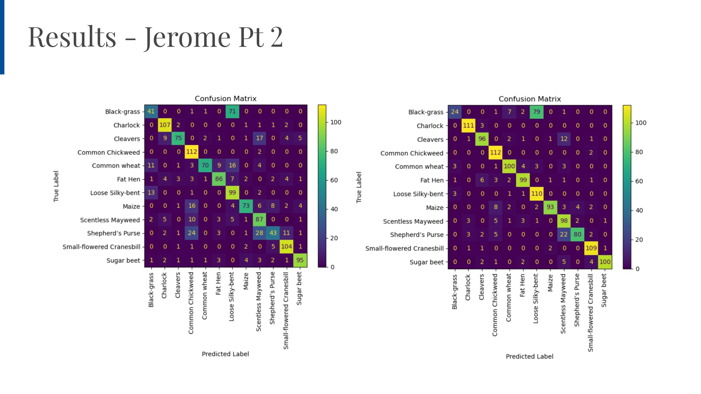
Notes:
AJ

Slide 15
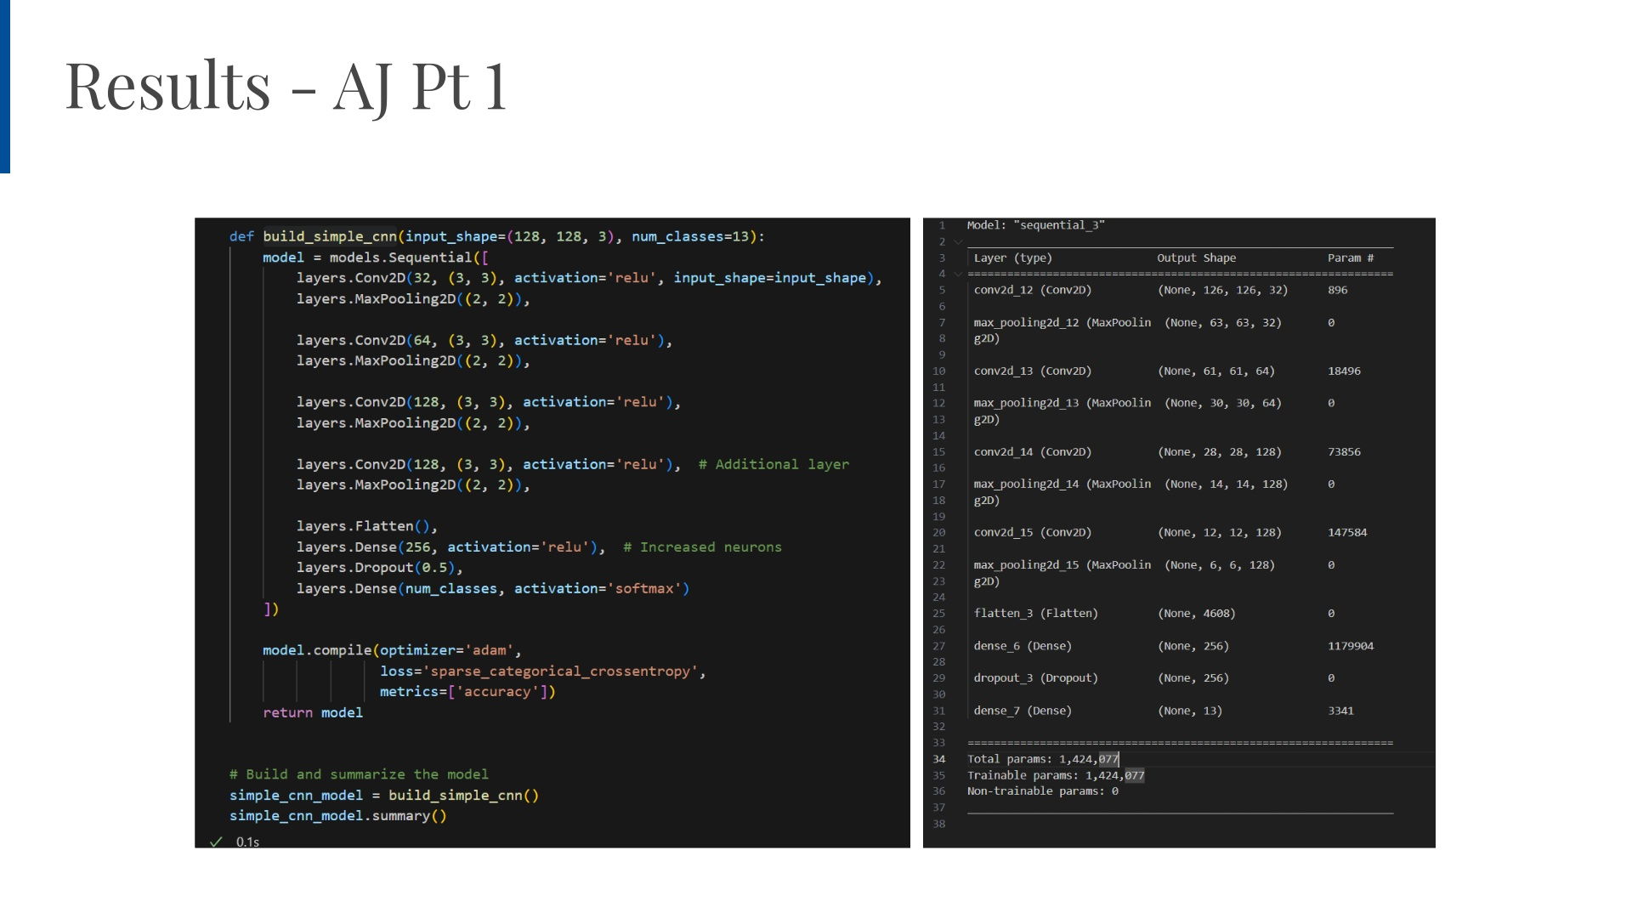
Notes:
AJ

Slide 16
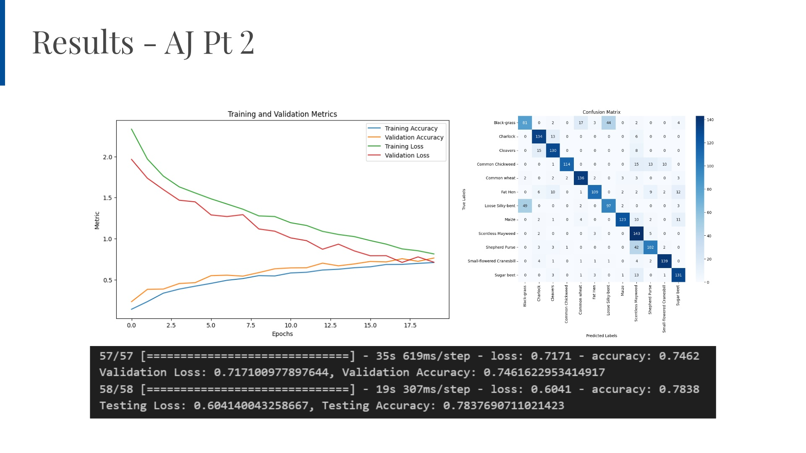
Notes:
AJ

Slide 17
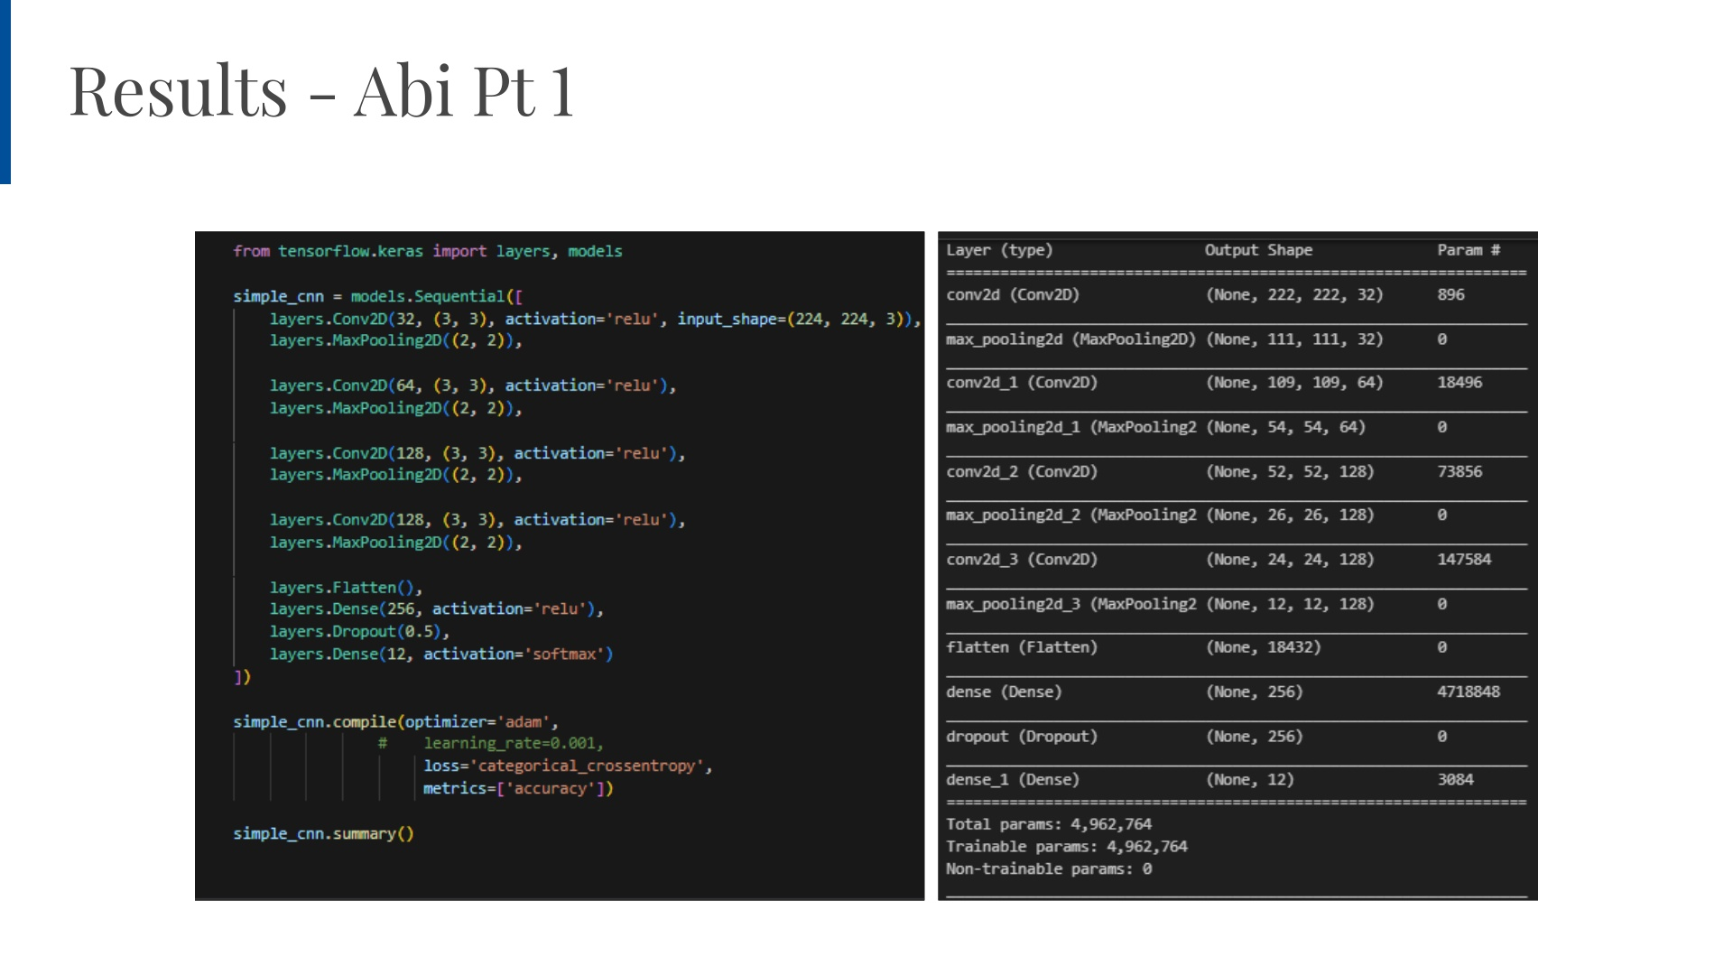
Notes:
AJ

Slide 18
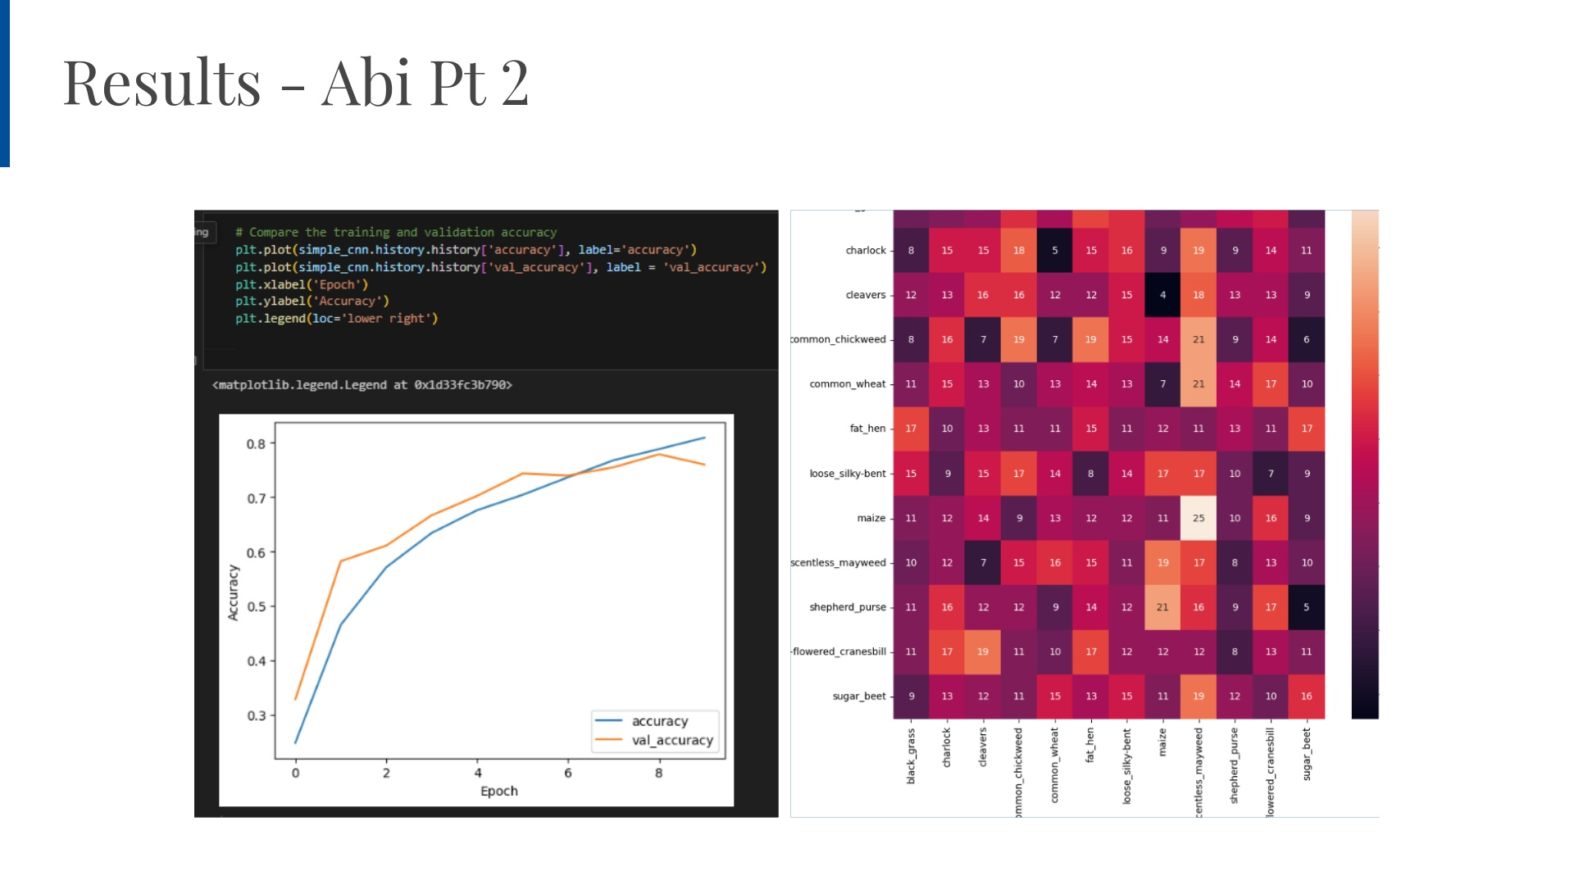
Notes:
AJ

Slide 19
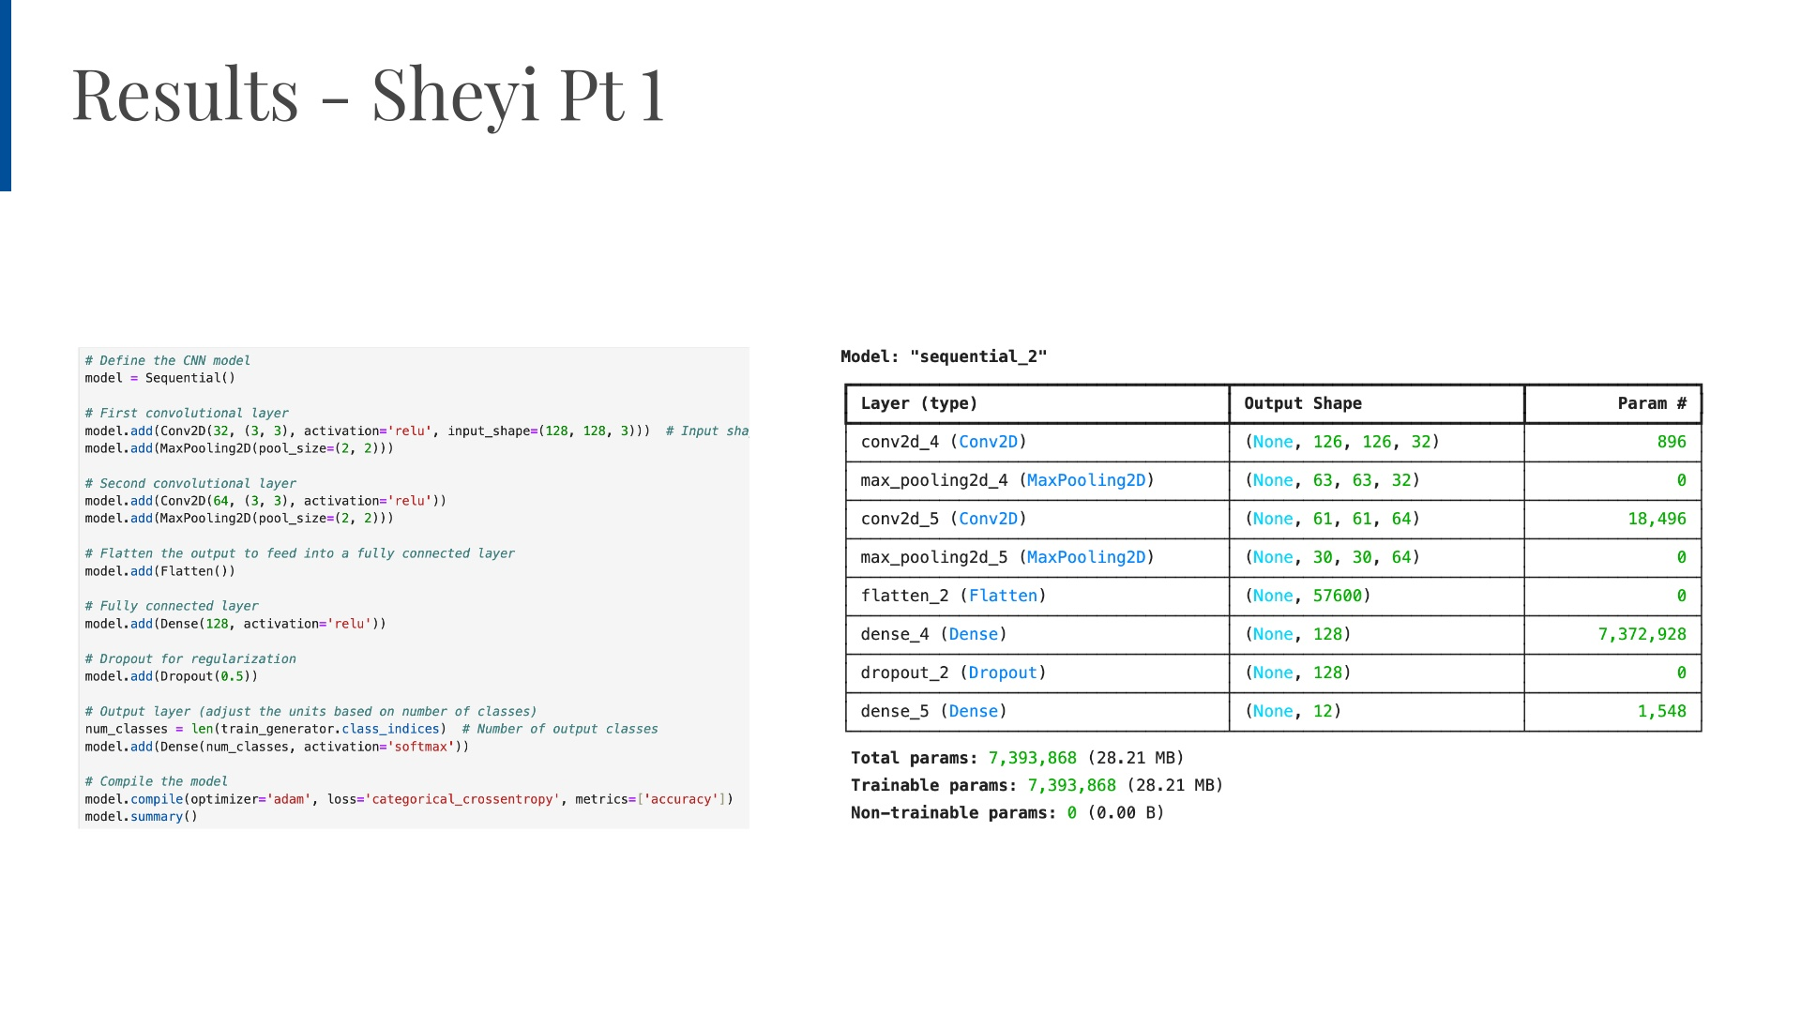
Notes:
AJ

Slide 20
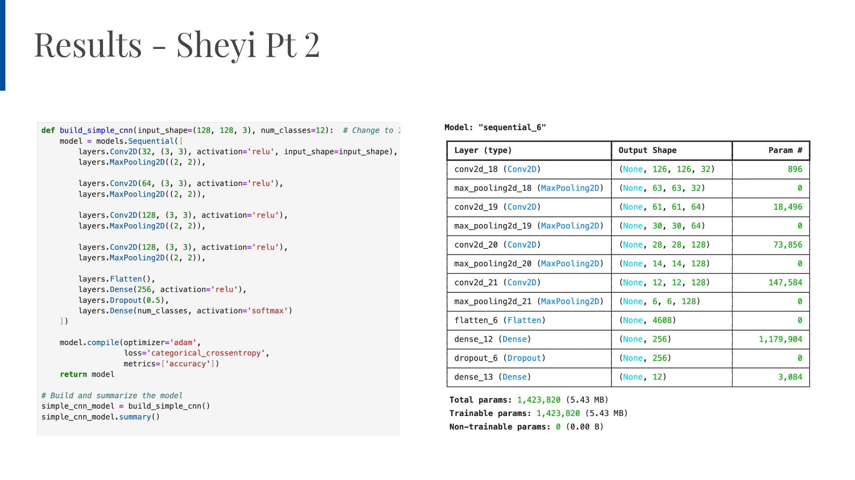
Notes:
AJ

Slide 21
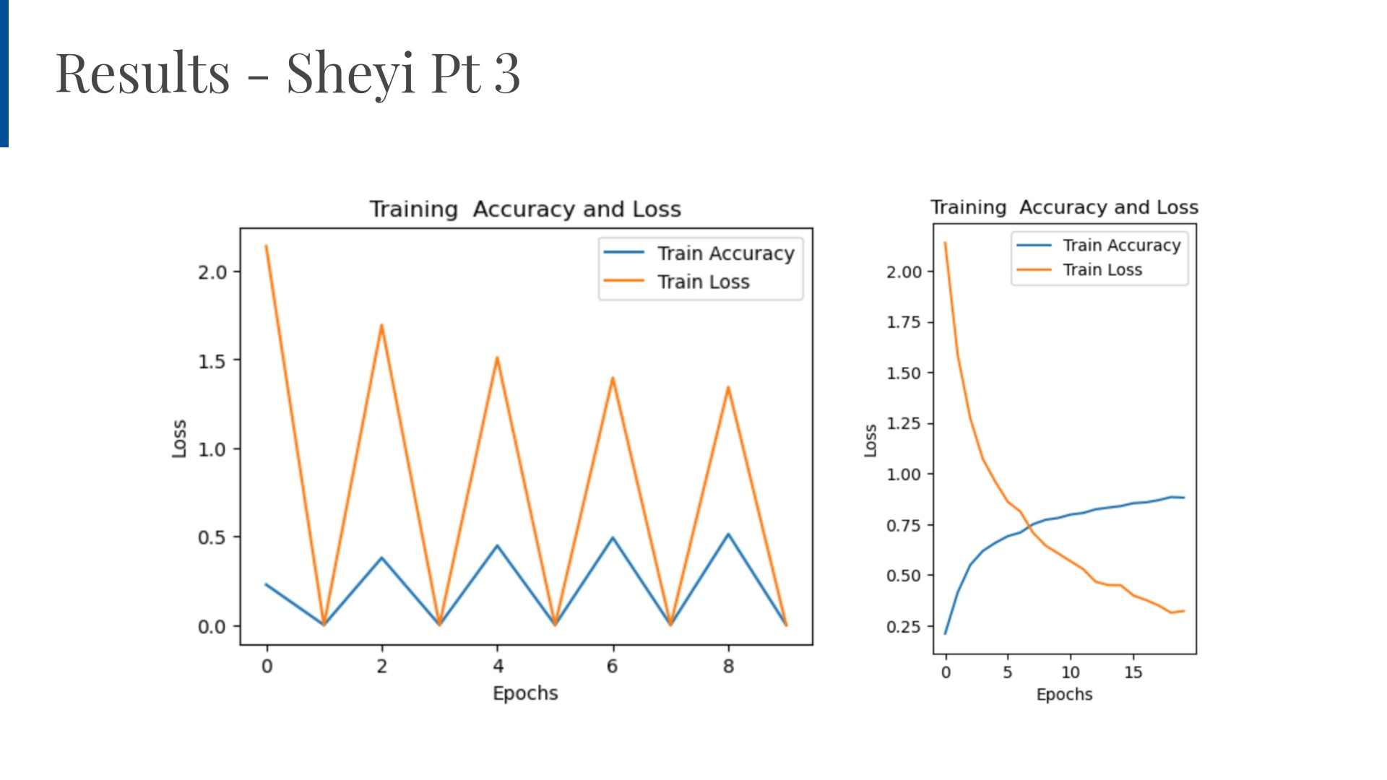
Notes:
AJ

Slide 22
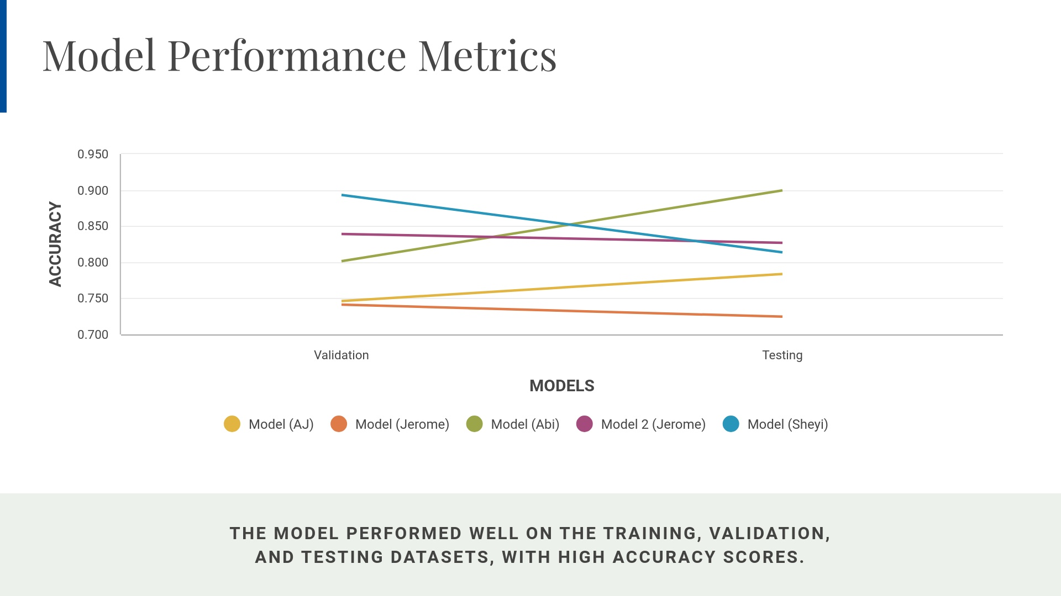
Notes:
AJ's model used [CNN architecture]It also used the original dataset, without oversampling, but used class weights to address the class imbalance.There were no augmentations used throughout the training.Jerome's models used an oversampled version of the dataset.The max number of images of all classes is 762, so the rest of the classes has been oversampled to have the same number of images across all classes.Different augmentations such as rotation, width shift, height shift, shear, zoom, and horizontal flip.

